Slide 1


Plant Med - An Automated App for Monitoring the tasks of Farmers
AARTHI .R

Slide 2
problem statement :
Farmers today are facing some serious challenges that affect their productivity. They often struggle with finding plant diseases early, which can lead to lower crop yields and higher costs. On top of that, many don’t have easy access to local weather information, making it hard to manage resources effectively. The current agricultural technologies can be complicated and don't always fit the needs of farmers, especially those in rural areas. Most importantly, there's a big gap between what farmers are growing and what the market actually wants; they often don't know which crops are in demand or which ones will be the most profitable. This shows us that there’s a real need for a better solution that helps farmers manage their plants while also staying in tune with market trends.

Slide 3
Solution :
PlantMed is an app that helps farmers make smarter decisions by combining AI-driven plant disease detection with real-time weather updates. Farmers can identify plant diseases from a photo and receive treatment advice, while also planning planting, watering, and harvesting based on weather data. The app analyzes soil conditions and market trends to recommend profitable crops. With multi-language support and an easy interface, PlantMed is a comprehensive, user-friendly tool for modern farming.

Slide 4
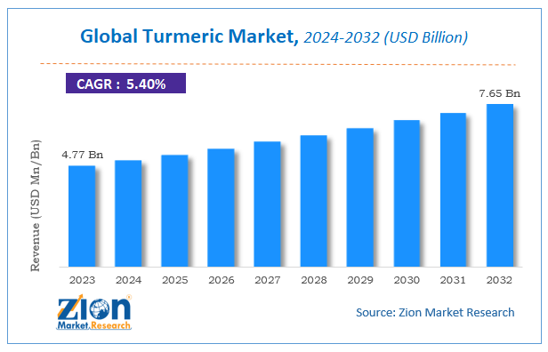
Market Potential and Crop Demand Analysis of TURMERIC
Turmeric in India is currently priced around ₹180-₹200 per kilogram in the wholesale market, while organic turmeric can reach as high as ₹300 per kilogram. These rates are significantly higher than staples like rice, which are around ₹20-₹30 per kilogram, though they lack the same consistency and price assurance that rice and wheat often receive.
4.7bn= approx. 33thousand -34thousand crore in inr
7.65bn= approx. 88thousand - 89thousand crore

Slide 5
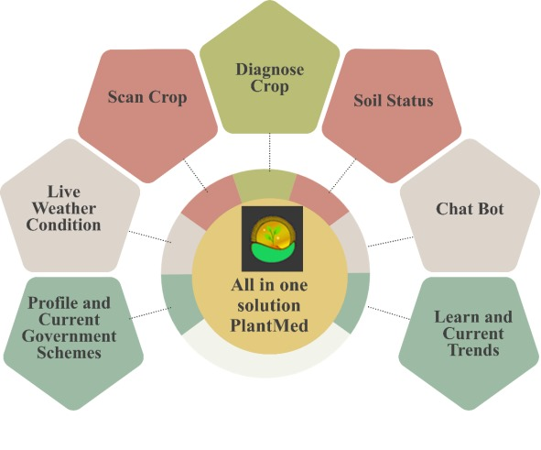
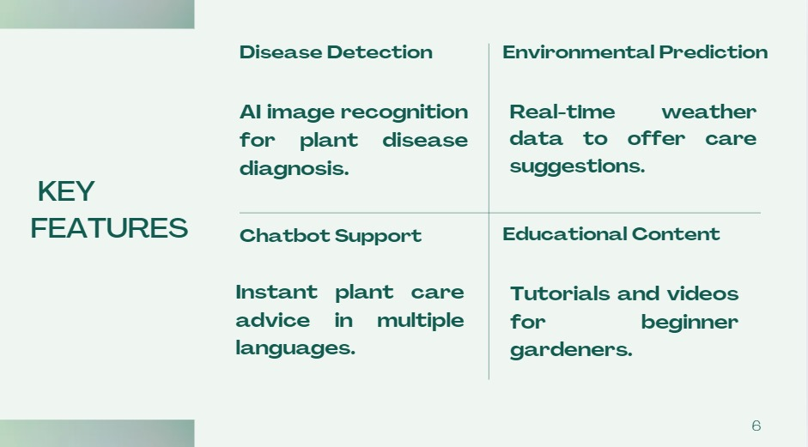

Slide 6
Feature | Existing Solutions | PlantMed
Financial and Social Support | PM-KISAN App (2021): Fund transfer to registered farmers; requires PM-KISAN Scheme registration and government eligibility. | Offers a dedicated section for government schemes and assistance programs, making it easy for farmers to understand and apply for relevant benefits.
Weather Data Integration | Kisan Suvidha (2016), AgroSmart: Provides weather updates but lacks disease prediction integration. | Combines real-time weather data with disease detection, offering personalized care recommendations based on the crop’s needs and current climate conditions.
Disease Detection via Image Processing | Plantix: Uses CNNs to detect plant diseases but is limited to general crop databases. | Utilizes a K-means and CNN model trained specifically on certain crops (e.g., tomatoes, bell peppers) from Plant Village dataset, ensuring high accuracy and relevance to regional farming needs.

Slide 7
Plant Care Assistance via Chatbot | Limited Chatbot (e.g., Plantix): Basic chatbot with no real-time guidance. | AI-powered chatbot “Eva” offers multilingual, real-time guidance on plant care, disease prevention, troubleshooting, and more, making support accessible even for beginners.
Trends and Market Insights | Kheti-Badi (2016): Focuses on organic farming without broader market or technology integration. | Educates farmers on emerging agricultural trends, from organic farming to smart technologies, enabling them to stay updated on modern techniques and tech-driven practices.

Slide 8
Technical Implementation of Each Feature :
User Interface (UI)
image processing and disease detection

Slide 9

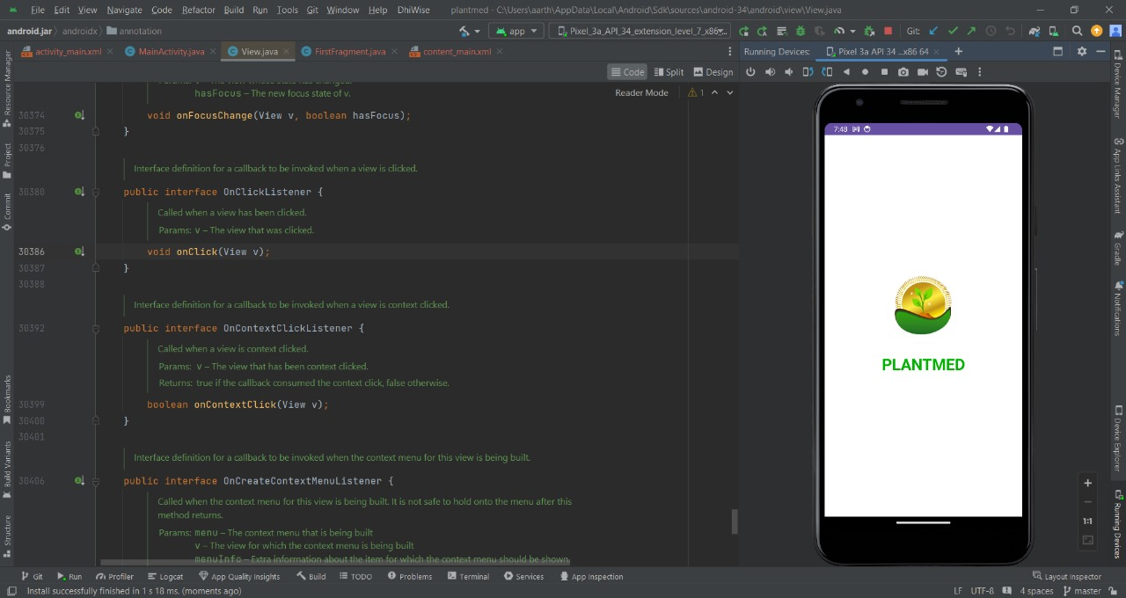
User Interface (UI)
To make PlantMed accessible and user-friendly, we developed a simple, intuitive interface using Android Studio. The app is designed to support multiple languages, so even a beginner can easily navigate and understand the features. From the main dashboard, users can upload images, view crop health updates, and get notifications. Each feature, like image upload or crop management, is placed to guide users naturally through the process, making PlantMed an inclusive tool.

Slide 10
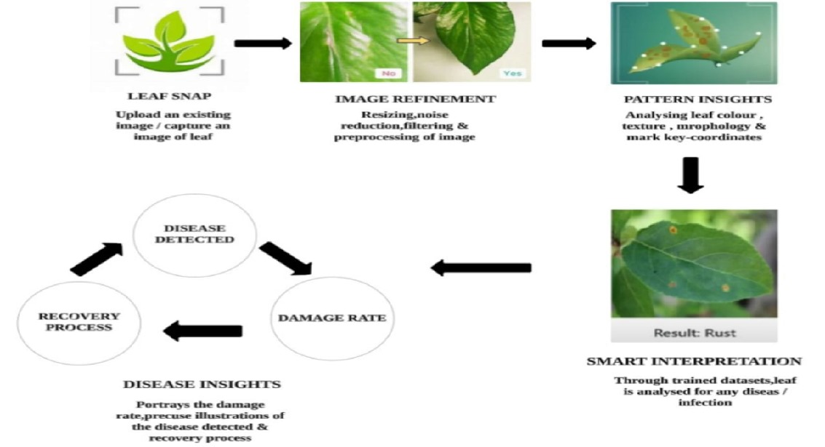
image processing and disease detection:

Slide 11
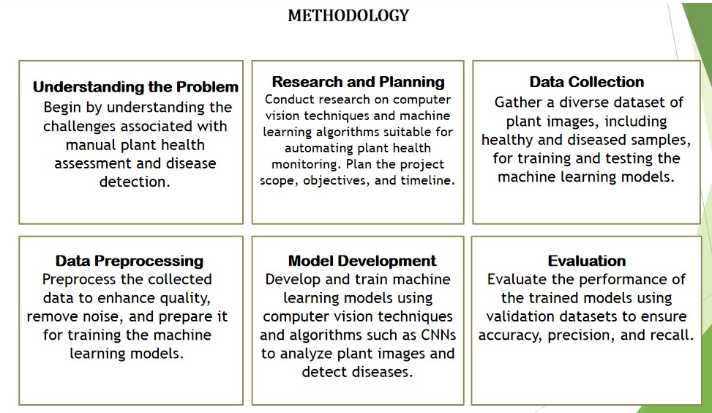
How it works
Methodology carried

Slide 12
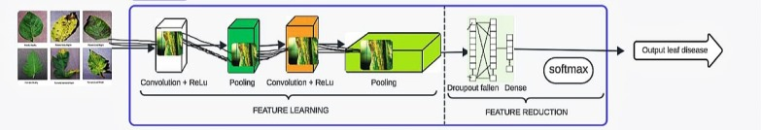
ALGORITHM USED : Convolutional Neural Networks (CNN)
CNN is employed to extract features from plant leaf images. The architecture consists of several layers, including convolutional layers, pooling layers, and fully connected layers.

Slide 13
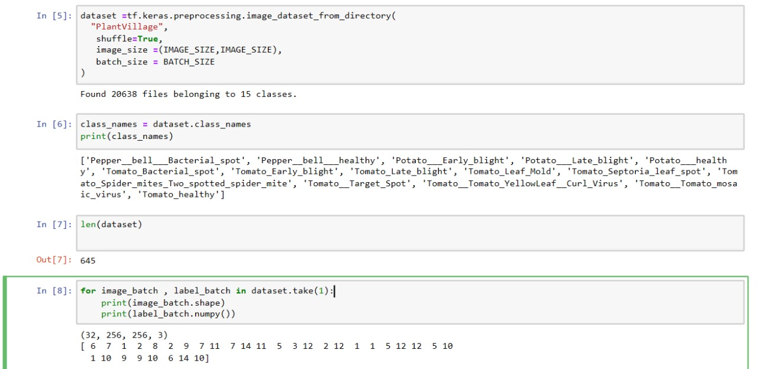
dataset loading and preprocessing :

Slide 14
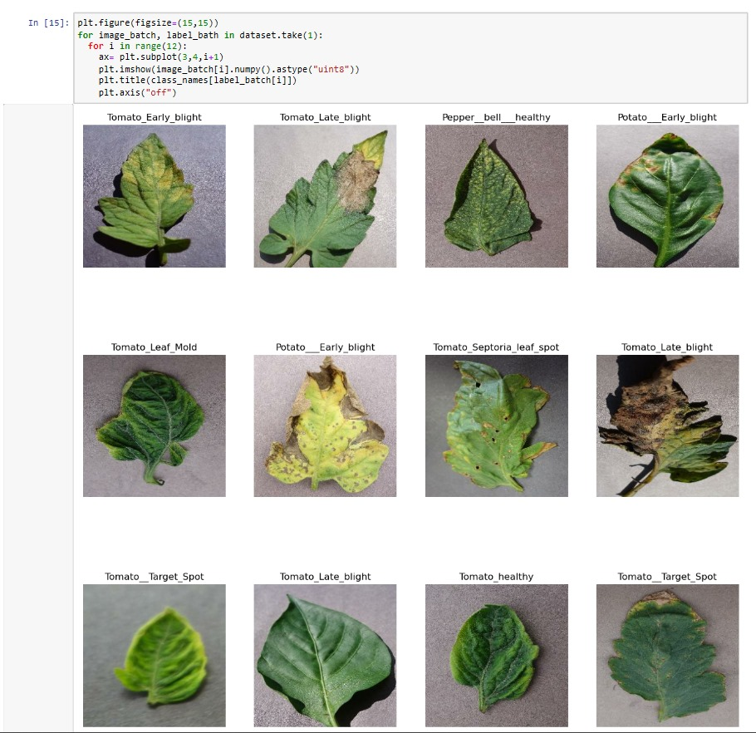
EDA process :

Slide 15
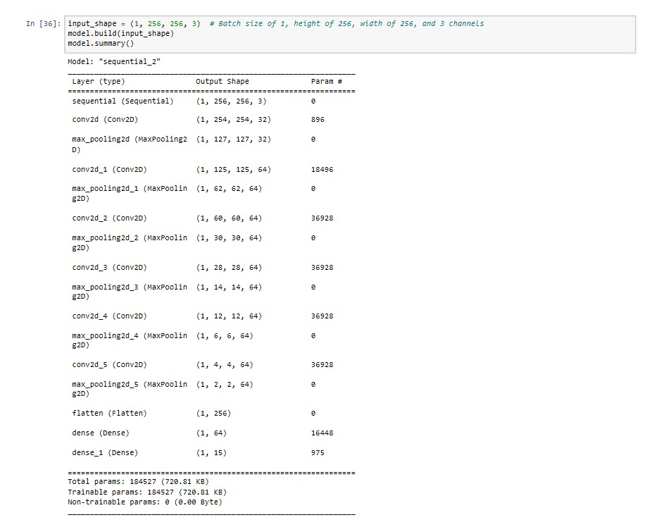
Convolutional Layer: Detects patterns such as edges, textures, and colors by applying filters to the image.
Pooling Layer: Reduces the image's dimensionality, helping the network focus on key features and speeds up learning.
Activation Function (ReLU): Introduces non-linearity, enhancing the model's ability to learn complex features.
Fully Connected Layer: The final layer in a CNN processes the flattened image data to output a prediction, classifying the disease

Slide 16
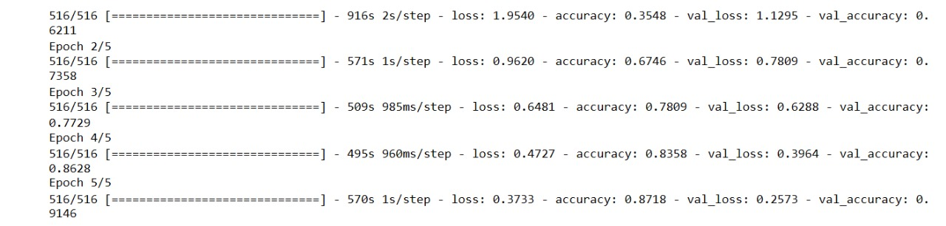
Training and validation accuracy

Slide 17
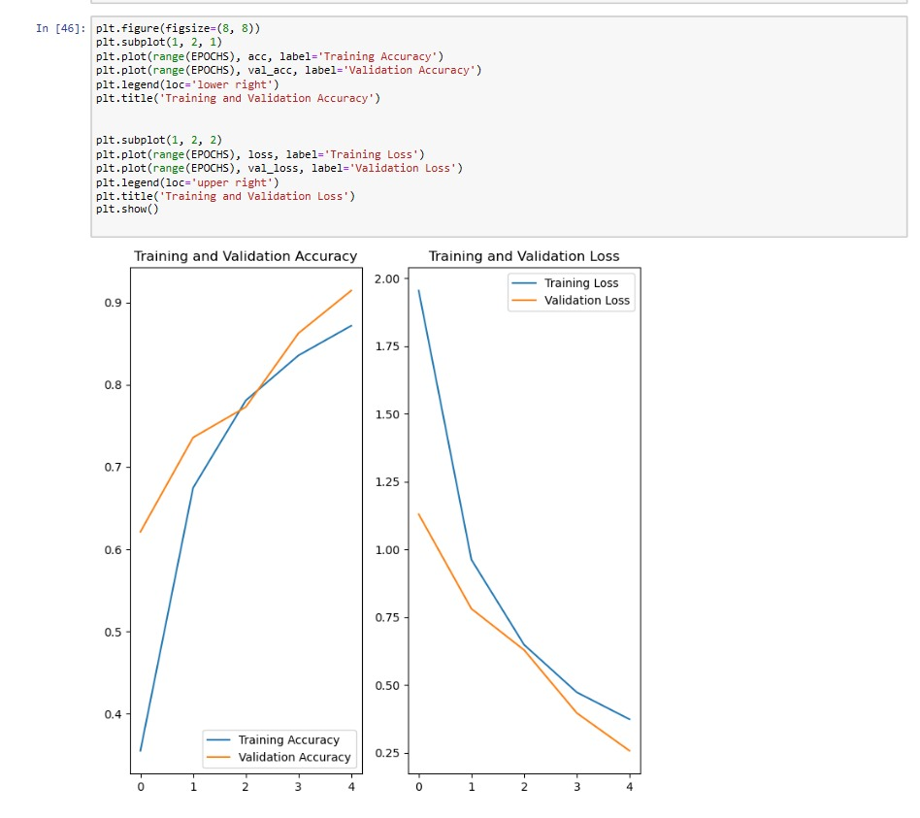
Training Loss: 0.3733, Training Accuracy: 87.18%
Validation Loss: 0.2573, Validation Accuracy: 91.46%

Slide 18
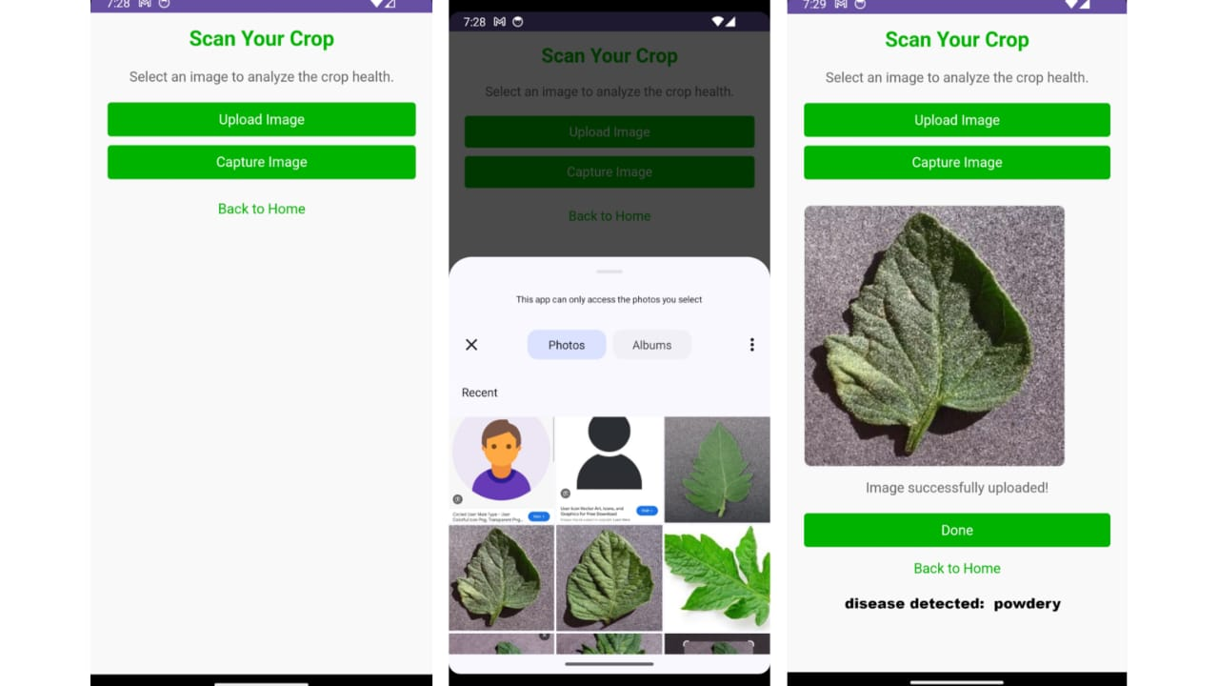

Slide 19
Chatbot
Project Setup : Created a new Dialog flow agent tailored to our plant disease detection and agricultural advice project . Defined agent language and time zone based on the target audience.
Designing Intents Common Queries: Created intents for user questions, e.g., “What to do for yellow leaves?” and “How to identify tomato plant diseases ?” Training Phrases: Included multiple user input examples for accurate recognition. Responses: Provided tailored answers, such as care instructions for identified issues.
Adding Entities : Created entities for plant types (e.g., "tomato", "turmeric") and diseases (e.g., "leaf blight", "root rot") to extract specific information.
Machine Learning Integration : User Interaction: Captured images uploaded by users for diagnosis . Model Prediction: Leveraged a trained model to analyze images and predict diseases . Response Generation: Provided users with diagnoses and care instructions based on model predictions.
Multi-Language Support : Configured the agent for multiple languages, allowing users to interact in their preferred language.

Slide 20
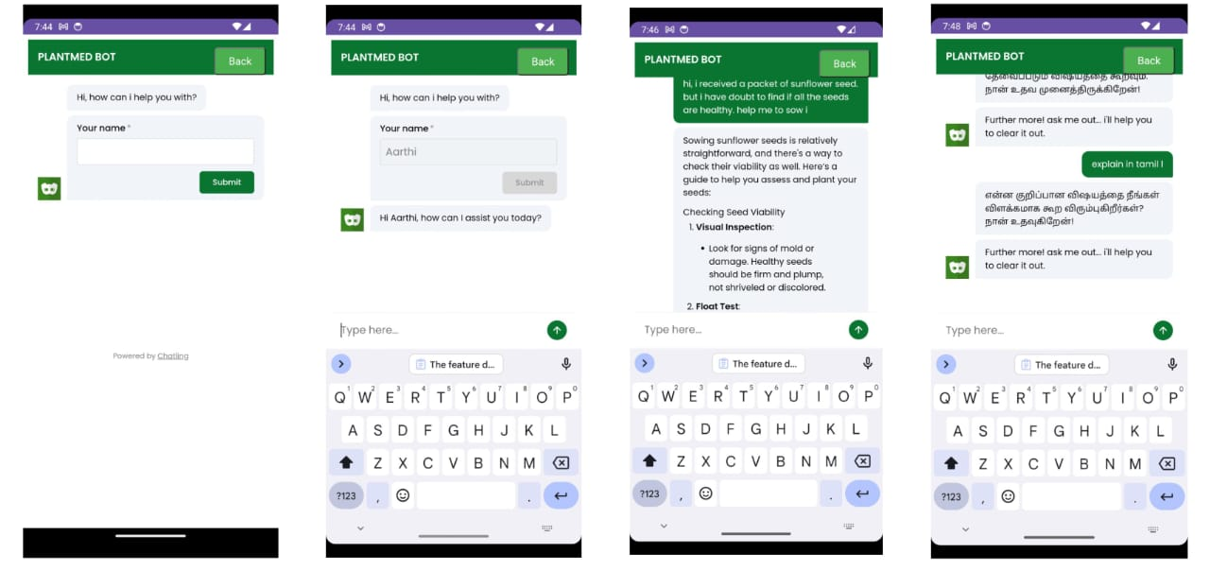
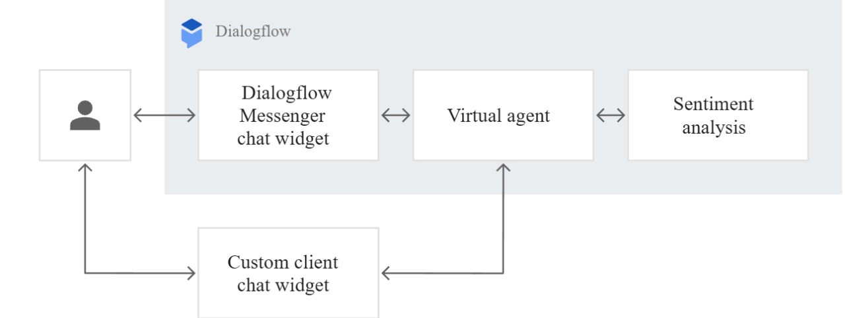

Slide 21
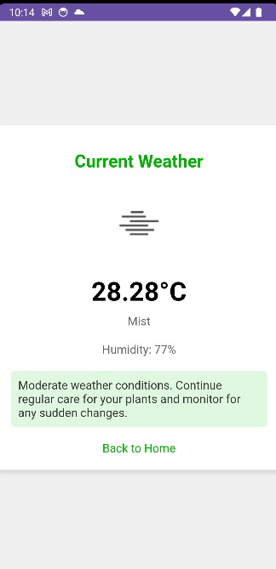
weather api integration
1. API Selection Chose a reliable weather API (e.g., OpenWeatherMap, Weatherstack) for accurate and comprehensive weather data.
2 . Key Features of Integration :
Current Weather Data : Retrieves temperature, humidity, precipitation, and wind speed for user-defined locations.
Forecasting : Provides short-term and long-term weather forecasts to inform users about upcoming weather conditions .
API Key Setup: Registered for an API key for authentication.
API Calls: Developed functions to make API requests and handle responses, parsing relevant weather data .
Display Data: Created user-friendly interfaces to present weather information in the app.
Suggest optimal planting and harvesting times based on current and forecasted weather conditions.
Alert users about adverse weather conditions (e.g., storms, droughts) that could affect crop health.

Slide 22
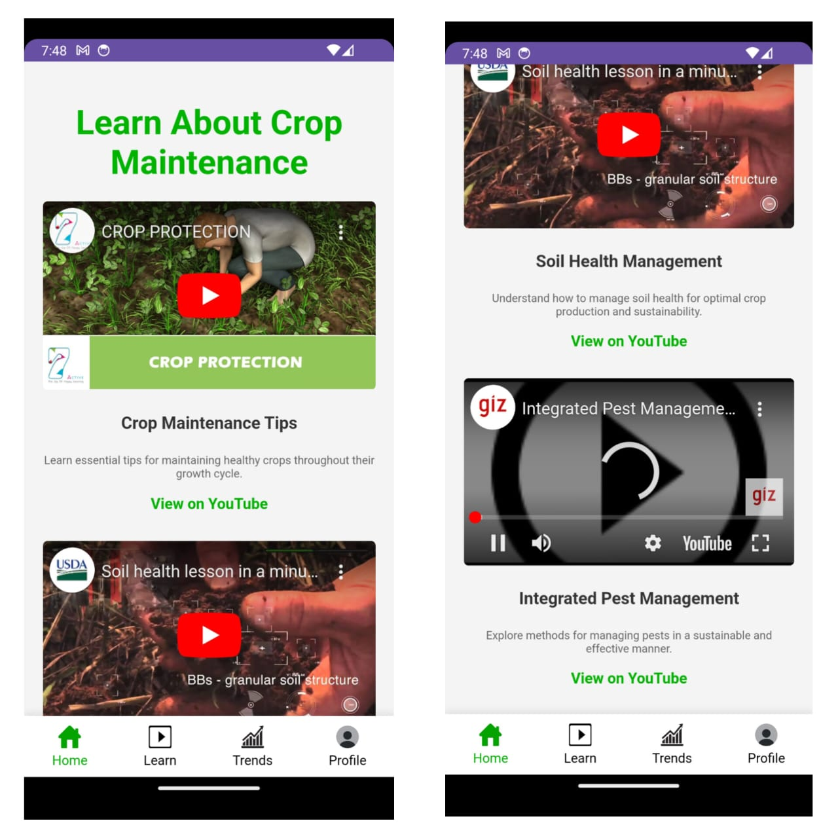
learn
The "Learn" section is designed to equip users with valuable knowledge and skills in agriculture through a variety of educational resources. It features a curated list of informative articles that cover essential topics related to crop management, sustainable farming practices, and innovative agricultural techniques. These articles delve into critical subjects such as soil health, pest management, and the importance of crop rotation, offering readers insights into best practices that can enhance their farming success. Additionally, the platform provides access to video tutorials that visually demonstrate modern agricultural practices. Users can find engaging content ranging from organic farming methods to the application of technology in precision agriculture. These resources aim to empower farmers by giving them the tools they need to make informed decisions and improve their agricultural techniques.

Slide 23
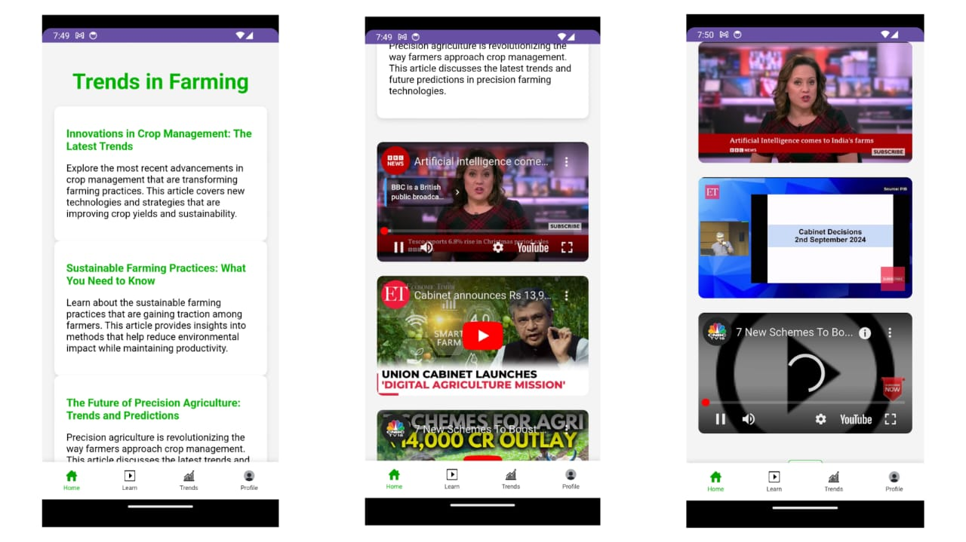
Trends Tools:
The "Trends" section focuses on providing users with real-time insights into current market trends in agriculture. By utilizing advanced analytics tools, users can stay updated on which crops are in high demand, allowing them to make strategic decisions about what to plant and when. This section offers access to data-driven insights, powered by machine learning models that analyze historical data and predict future trends in crop yields and market demands. By presenting reports and visualizations, users can easily understand market fluctuations, pricing dynamics, and consumer preferences. Furthermore, the platform keeps farmers informed about significant events, such as natural disasters or market shifts, which could impact their operations. Overall, the "Trends" tools aim to enhance farmers' ability to navigate the market effectively and capitalize on profitable opportunities.

Slide 24
Ongoing Simulated Feature Development :
For this initial prototype, I’ve simulated environmental data, including humidity, pH, and temperature, using random functions. This allows us to demonstrate the core functionalities of the application effectively . The simulation serves as a preliminary showcase of how the application will operate when fully integrated with actual predictive models.
n the next stages, I plan to replace the simulated data with machine learning models trained on real datasets. This transition will ensure that our predictions are accurate and reliable.
The development process will involve fine-tuning the model's accuracy, optimizing performance to provide users with actionable insights.

Slide 25
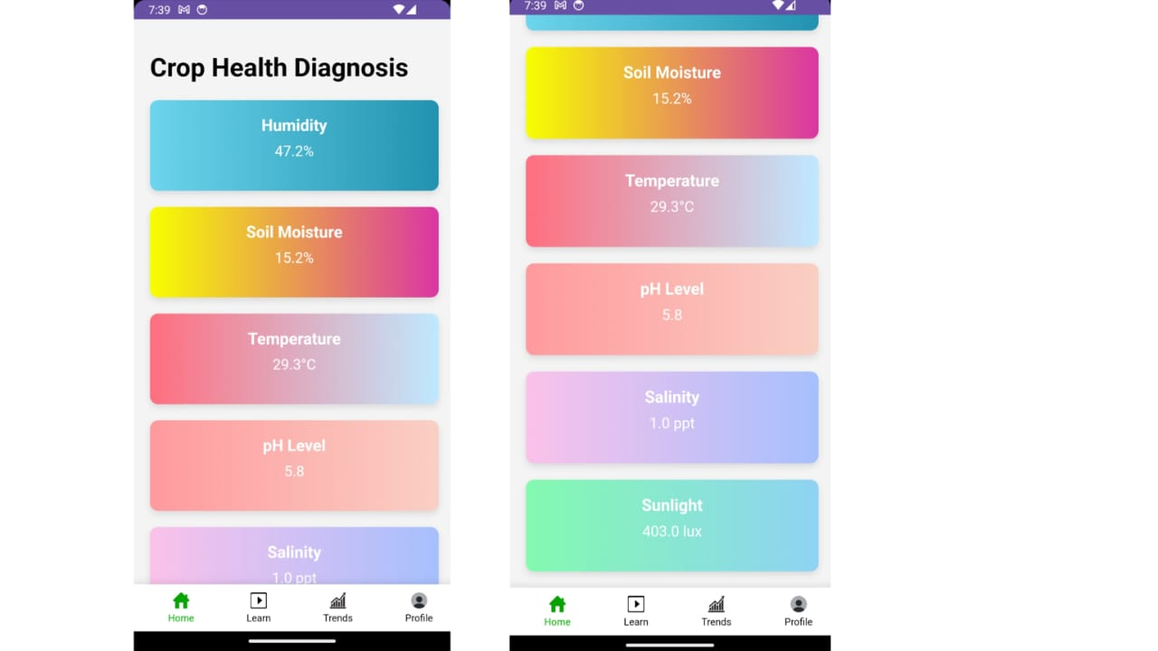
Cost-Effective Solutions:
This approach not only aims to enhance prediction accuracy but also offers a cost-effective solution, as it minimizes the need for physical sensors while still delivering high-quality, data-driven insights .
My goal is to advance the prototype with validated data sources, ultimately providing users with a robust tool for informed decision making in agriculture.

Slide 26
Soil Status :
The ongoing development of our soil status monitoring feature currently utilizes simulated data for moisture levels, pH, and nutrient content, allowing us to demonstrate how this functionality will enhance crop management within the app. In future stages, we plan to replace this simulated data with actual measurements from integrated sensors and machine learning algorithms to provide accurate insights into soil health. This approach not only helps keep initial development costs low but also empowers farmers to make informed decisions based on real-time soil data, ultimately promoting better crop yields and sustainable agricultural practices.

Slide 27
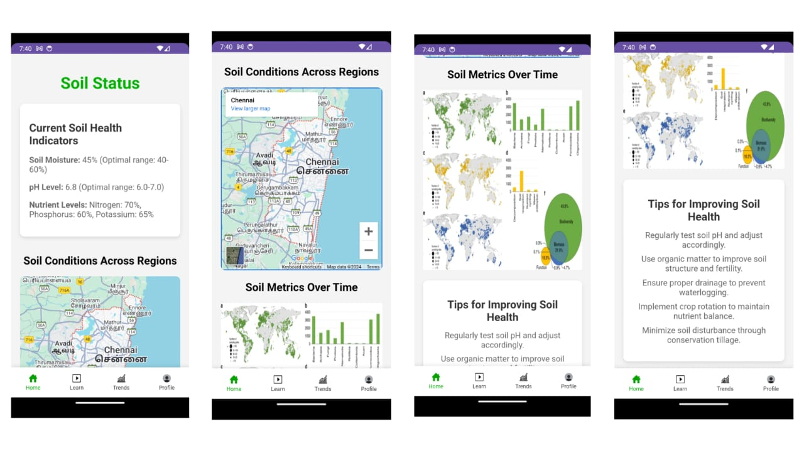

Slide 28
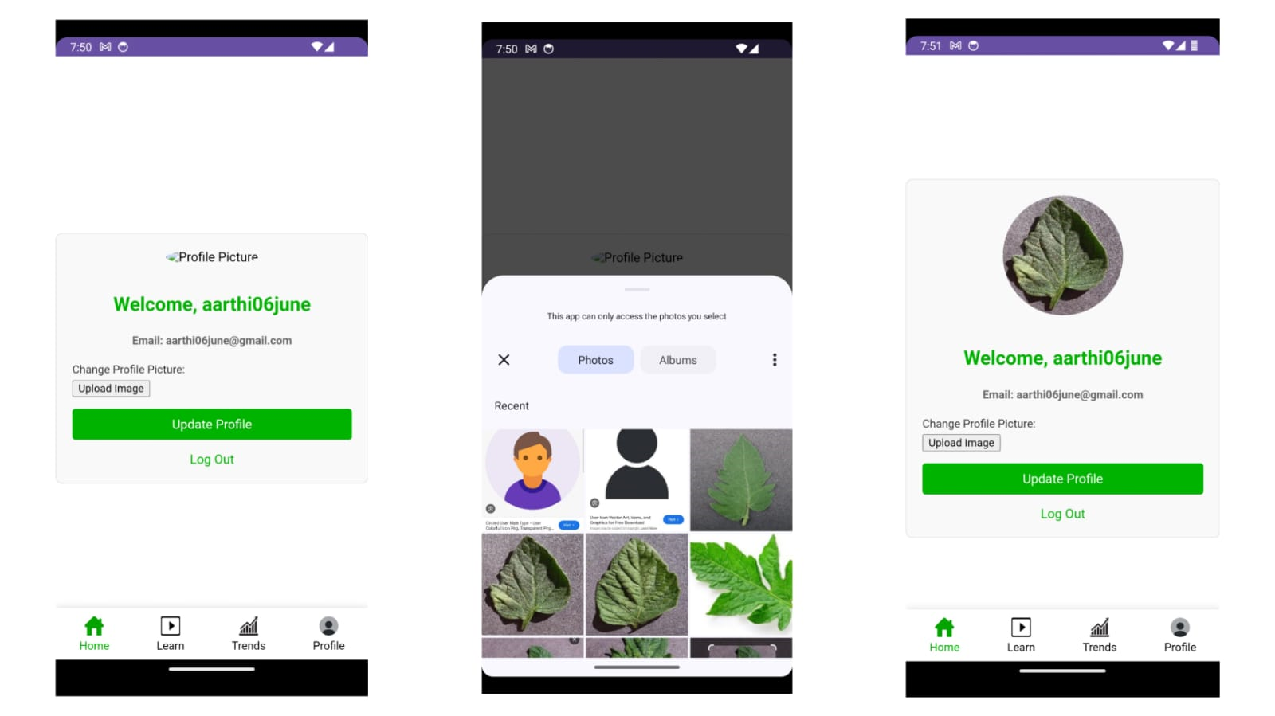
Profile Section
In the profile section, users can easily access and manage their personal information, including name, contact details, and farming preferences. This customizable space allows farmers to set their crop interests, track their planted crops, and receive tailored notifications and insights based on their specific farming activities. By personalizing their profiles, users can optimize their experience and enhance their engagement with the app’s features.

Slide 29
future implementations :
Crop Database and Tracking System
Real-Time Weather Alerts and Preventive Measures

Slide 30
Crop Database and Tracking System
Future implementations will enable users to create comprehensive databases for the crops they sow, allowing them to track the growth and health of their plants from planting to harvest. This system will provide constant updates and reminders, ensuring that farmers stay informed about their crops’ needs and schedules.

Slide 31
Real-Time Weather Alerts and Preventive Measures
The application will also feature real-time weather updates and alerts, notifying users of any extreme weather events such as cyclones or tornadoes. This proactive approach will help farmers take preventive measures, safeguarding their crops and minimizing potential losses.

Slide 32
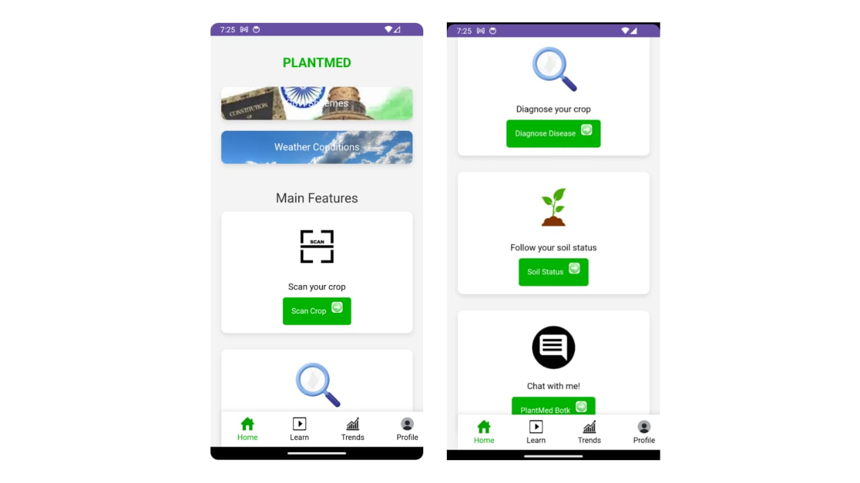
Home

Slide 33
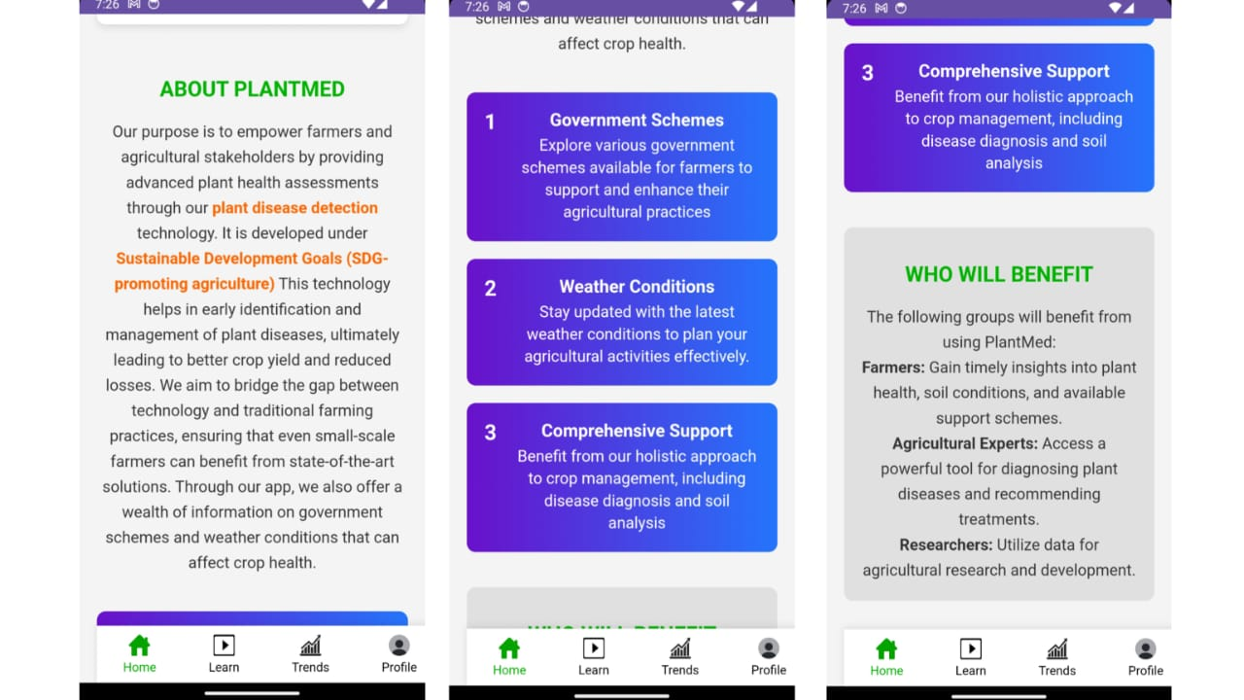
About

Slide 34
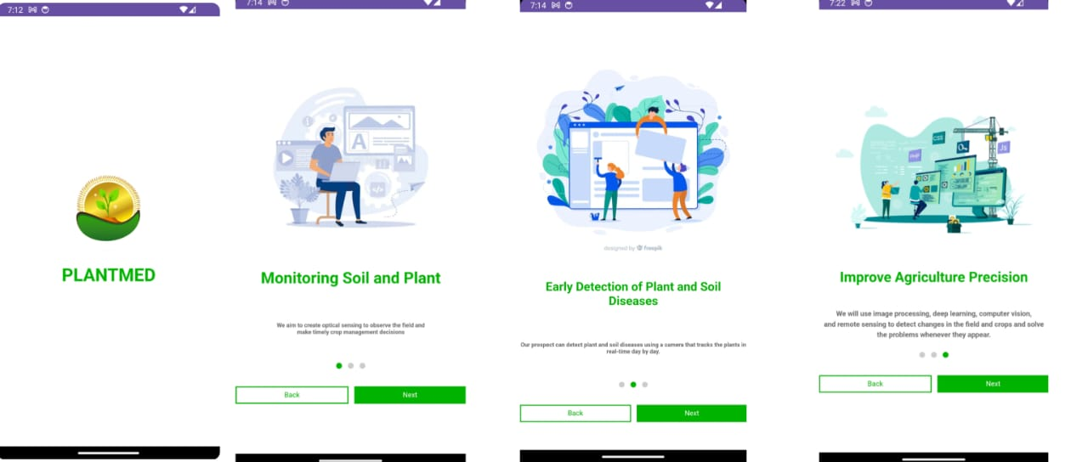
Product guide

Slide 35
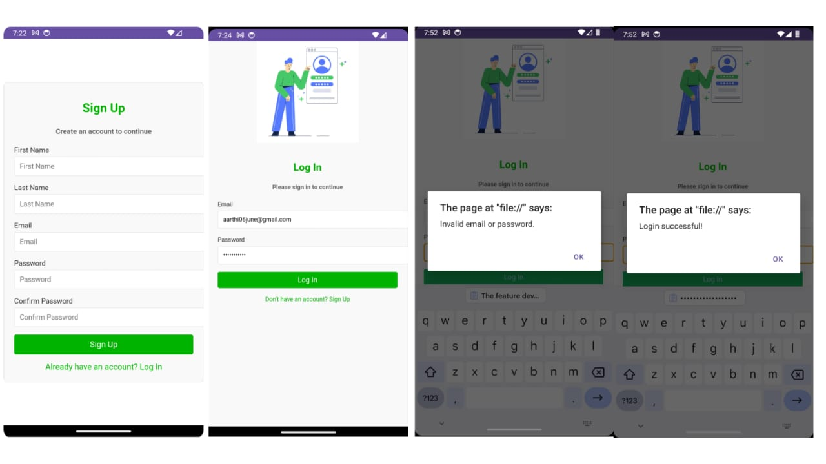
Sign-in and sign-up

Slide 36
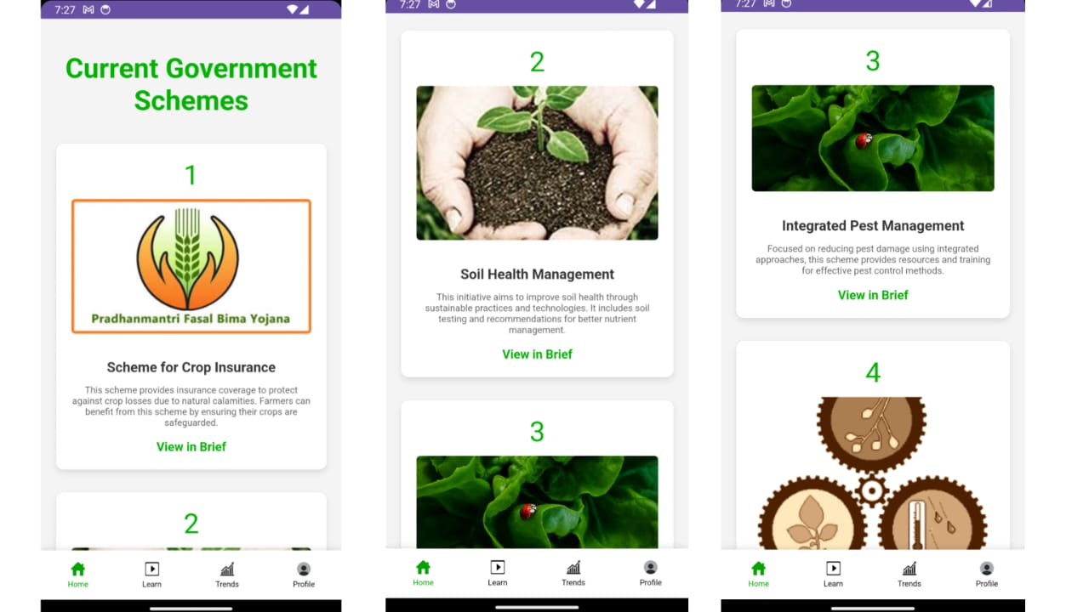
government schemes :

Slide 37
Conclusion:
In conclusion, our agricultural application not only aims to enhance the productivity and sustainability of farming practices but also aligns closely with the Sustainable Development Goals (SDGs). By promoting responsible consumption and production patterns, ensuring food security, and fostering innovation in agricultural practices, we contribute to building resilient communities.
The goal of this initiative is to empower farmers with the tools and knowledge to make informed decisions, improving their livelihoods while promoting environmental sustainability. By supporting individual farmers, the project has the potential to uplift entire communities through better food security, increased market competitiveness, and sustainable farming practices. We envision a future where farmers thrive, communities prosper, and ecosystems are preserved for future generations.

